Slide 1

Introduction to Analyzing Unstructured Data in Education
Please put into Slide Show Mode to begin interactive Quiz
(Slide Show → From Beginning)
Instructions
Click on responses to select answer.
Once selected, you can click on the same box to show original text.
Use navigation arrows to advance to next question
Question 1

Slide 2
1
Knowledge Check
Which of the following are unstructured data?
Tabular with a fixed schema
A
A CSV file of student IDs, grades, and test scores.
This is correct
A collection of students’ handwritten essays.
B
Tabular with a fixed schema
C
A relational database of item difficult parameters.
Semi-structured with flexible schema
D
A JSON file with a fixed schema of student demographics.
Next Question

Slide 3
2
Knowledge Check
A dataset can look structured yet hold unstructured data inside its cells. Which columns below contain unstructured data that would need text/signal processing before analysis?
This column holds free-form language inside a cell. The row/column shell is structured, but the content is unstructured and must be represented (tokens, embeddings) before modeling.
A
teacher_feedback: a free-text comment box.
This is a genuinely structured field and ready for analysis as is.
B
student_id: an integer key.
This is a genuinely structured field and ready for analysis as is.
C
submission_time: a datetime stamp.
This is a genuinely structured field and ready for analysis as is.
D
rubric_score: an integer 0 to 3.
Previous Question
Next Question

Slide 4
3
Knowledge Check
You are preparing student essays to feed into a transformer model (e.g., BERT). Which preprocessing choice is most appropriate?
Sometimes over-processing can erase construct-relevant information and hurt performance.
A
Lowercase, remove all punctuation, strip stopwords, and stem every word before encoding.
Replace every word with its dictionary definition to add meaning.
B
Sometimes over-processing can erase construct-relevant information and hurt performance.
Clean only what you need to. Modern transformer models are
pretrained on raw text and have their own subword tokenizers.
C
Apply only light cleaning (e.g., fix encoding, strip markup) and keep the text largely raw.
Sometimes over-processing can erase construct-relevant information and hurt performance.
D
Convert the essay to a bag-of-words count vector first, then feed it to BERT.
Previous Question
Next Question

Slide 5
4
Knowledge Check
You receive scanned images of students' handwritten worksheets, each containing both handwritten text and a hand-drawn picture. To prepare these for analysis, which preprocessing approach is most appropriate?
Handwritten Text Recognition will expect text; running it over a drawing will yield meaningless output and lose the picture's content.
A
Apply handwritten text recognition to the entire page, including the drawing.
Without separating regions, the text and drawing are mixed together and neither is captured accurately.
B
Treat the whole scan as a single block and skip region segmentation.
Manually retype only the text and discard the drawing.
C
This approach will throw away construct-relevant information (the drawing) and does not scale to many worksheets.
Different content types require different recognition methods; segmenting the page first lets each region be digitized appropriately.
D
First run layout analysis to separate the page into regions (title, body text, drawing), then apply handwritten text recognition (HTR) to the text regions and computer vision (CV) to the drawing region.
Previous Question
Next Question

Slide 6
5
Knowledge Check
A model assigns the word ''bank'' different vectors in ''river bank'' versus ''savings bank.'' Which family of representations is being used?
Contextual models produce a vector that depends on the surrounding sentence, so the same word can have different vectors for different meanings.
A
Static embeddings (e.g., Word2Vec, GloVe, fastText).
Contextual models produce a vector that depends on the surrounding sentence, so the same word can have different vectors for different meanings.
B
Bag-of-words and TF-IDF counts.
Hand-crafted features (word count, frequency).
C
Contextual models produce a vector that depends on the surrounding sentence, so the same word can have different vectors for different meanings.
Contextual embeddings (e.g., BERT, RoBERTa).
D
Contextual models produce a vector that depends on the surrounding sentence, so the same word can have different vectors for different meanings.
Previous Question
Next Question

Slide 7
6
Knowledge Check
In a shared embedding space, a student's plant drawing ends up close to the text ''photosynthesis.'' What makes this cross-modality comparison possible?
Correct!
A
Both the image and the text are mapped into one common vector space, where closeness reflects similar meaning.
Cosine similarity can only be computed between two items of the same modality.
B
False: cosine similarity measure works across modalities once they share a space.
False: a shared embedding encoder can handle images directly.
C
The drawing must first be converted into text before any comparison is possible.
Items from different modalities can be close even when they share no common surface form.
D
Correct!
Previous Question
Next Question

Slide 8
7
Knowledge Check
You have 500 essays, each scored 1-6 by trained human raters, and you want a model to score new essays on the same scale. Which family fits best?
This column holds free-form language inside a cell. The row/column shell is structured, but the content is unstructured and must be represented (tokens, embeddings) before modeling.
A
Supervised learning
This is a genuinely structured field and ready for analysis as is.
B
Unsupervised learning
This is a genuinely structured field and ready for analysis as is.
C
Network analysis
This is a genuinely structured field and ready for analysis as is.
D
Topic modeling
Previous Question
Next Question

Slide 9
8
Knowledge Check
Which of the following are unsupervised analyses (no labeled outcomes required)? (Select all that apply)
This analysis discovers structure with no labels.
A
Clustering students by response similarity
Dimensionality reduction with UMAP for visualization
This analysis discovers structure with no labels.
B
Uses labels (on-/off-task) → supervised.
C
Training a classifier on labeled on-/off-task data
Predicts a known outcome (dropout) → supervised.
D
Predicting next-week dropout from past grades
Previous Question
Next Question

Slide 10
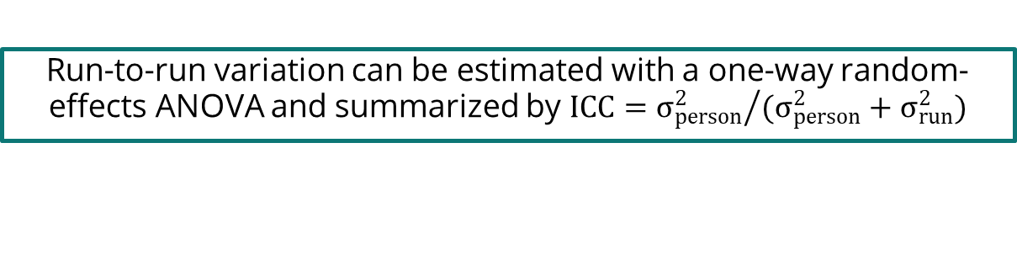
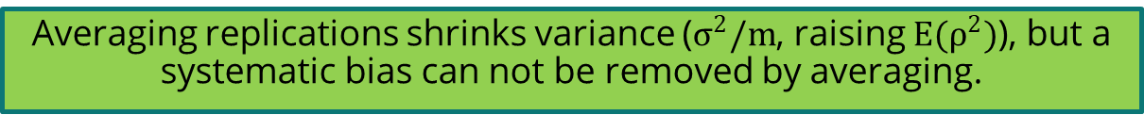
9
Knowledge Check
An LLM scores the same responses repeatedly. Which statements are incorrect?
This is a correct statement
A
Run-to-run variation can be estimated with a one-way random-effects ANOVA and summarized by $ICC={σ_{person}^{2}}/{(σ_{person}^{2}+σ_{run}^{2})}$
Prompt sensitivity can be assessed by rewording the rubric in meaning-preserving paraphrases and checking that scores stay stable.
B
This is a correct statement
Averaging replications shrinks variance ($σ^{2}/m$, raising $E(ρ^{2})$), but a systematic bias can not be removed by averaging.
C
Averaging m number of self-consistency draws reduces variance and removes order-effect bias.
This is a correct statement
D
Order effects in LLM-as-judge are a systematic bias, can be mitigated by swapping or randomizing presentation order.
Previous Question
Next Question

Slide 11
10
Knowledge Check
An AI scorer rates argumentation and evidence quality in student essays. Which features, if they drive the score, are NOT the signs the model is exploiting a surface proxy rather than the construct?
Logical linkage between each claim and its supporting evidence.
A
This is the construct (claim to evidence linkage), so relying on it is valid, not a proxy.
Total essay length (word count)
B
This is a surface proxy. it correlates with quality in training but are not the construct.
This is a surface proxy. it correlates with quality in training but are not the construct.
C
Density of sophisticated vocabulary, regardless of relevance
This is a surface proxy. it correlates with quality in training but are not the construct.
D
Presence of ''shell'' academic phrasing (e.g., ''The passage concludes that…)
Previous Question
Next Question

Slide 12

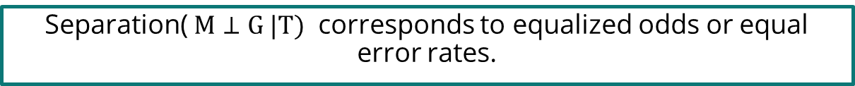


11
Knowledge Check
Let$M$ be the predicted score, $T$ the target, $G$ the student group. Which statements are correct?
Sufficiency ( $T⊥G|M$) corresponds to calibration within groups.
A
This is a standard correspondence among the three criteria.
When base rates differ and prediction is imperfect, sufficiency (calibration) and separation (equalized odds) cannot both hold.
When group base rates differ and the predictor is imperfect, sufficiency and separation can both hold at once.
B
Independence ($M⊥G)$ corresponds to demographic parity.
C
This is a standard correspondence among the three criteria.
This is a standard correspondence among the three criteria.
D
Separation( $M⊥G |T)$ corresponds to equalized odds or equal error rates.
Previous Question
Next Question

Slide 13
12
Knowledge Check
Your team stores only the embeddings of student essays and voice responses, not the raw files, and calls them ''anonymous.'' Which statements are incorrect?
A scored item response is generally far less identifying than the raw essay or voice clip it came from.
A
Raw responses are more identifying, embeddings are vulnerable to inversion.
Embeddings are not anonymous by default
Storing only embeddings guarantees the original text, voice, or face cannot be recovered.
B
Inversion attacks can reconstruct the original input from its embedding.
C
This is correct.
Voice/behavior are biometric.
D
Voice prints and behavioral patterns in logs can serve as biometric identifiers.
Previous Question
Next Question

Slide 14
13
Knowledge Check
A district recorded classroom observation videos for teacher feedback and now wants to reuse them to train a student-engagement model. Under the consent principles in this section, which are NOT required?
The teacher's verbal agreement to record the class covers the students who appear in the video.
A
The teacher cannot consent on the students’ behalf; the students and, for minors, their guardians, must.
A specific opt-in for the new secondary use; consent to teacher feedback is not consent to model training.
B
This is correct.
This is correct.
C
A plain-language, age-appropriate notice of what is collected and why.
This is correct.
D
A real withdrawal path, with downstream deletion that actually propagates.
Previous Question
Next Question

Slide 15
14
Knowledge Check
Which statements about technical safeguards and data sensitivity are incorrect?
This is a correct statement
A
Quasi-identifiers (e.g., essay topic + classroom + date) can reidentify a student even when no field names them.
Differential privacy and federated learning are examples of formal privacy techniques.
B
This is a correct statement
Encryption does not stop a model from leaking or inferring sensitive content at output.
C
Output filtering (e.g., blocking verbatim leakage, suppressing sensitive inferences) is unnecessary as long as data are encrypted.
Previous Question
Next Question

Slide 16
You have reached the end of this learning check
Please click anywhere to exit!
Previous Question

