Slide 1
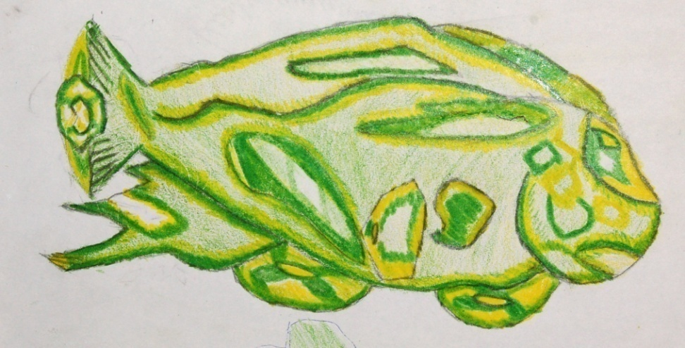
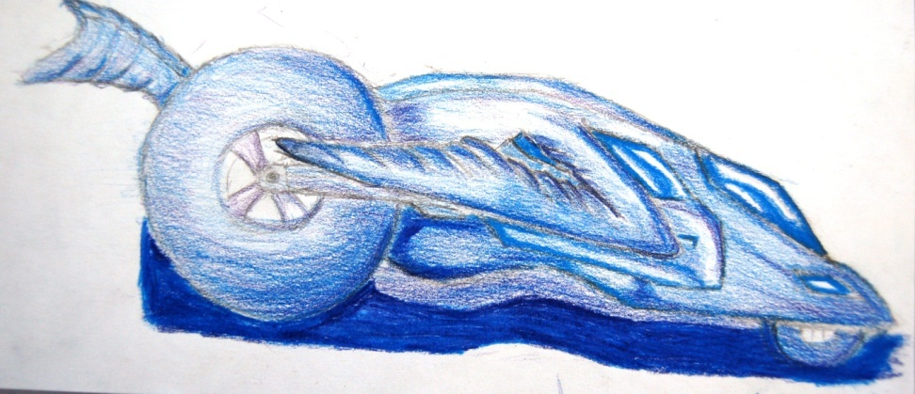
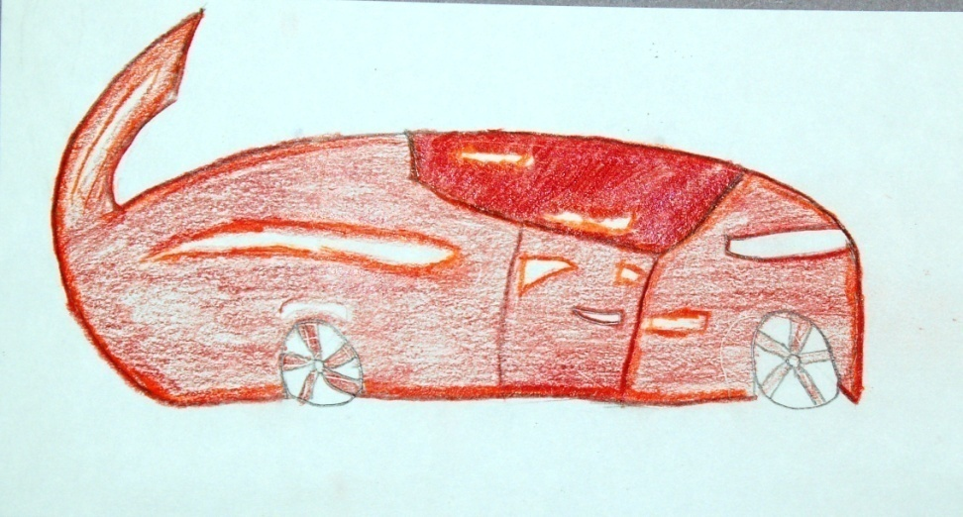
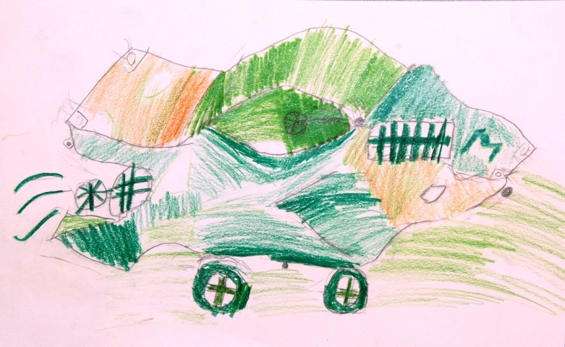
Gradation Rubric IS 223–K: 7th Grade, Jason Rondonelli & Emily Maddy
4
3
2
1

Slide 2
Guidelines and Source
Task-specific visual rubrics use images instead of or as well as text to communicate levels of quality in student work. Students can compare a peer's work to an image and also indicate which features of other images could be emulated.
Source: Andrade, H., Hefferen, J., & Palma, M. (2014). Formative assessment in the visual arts. Art Education Journal, 67(1), 34-40.
More examples of visual rubrics in the arts can be found here: http://artsassessmentforlearning.org/
Recommended for English Learners, students with disabilities, and all students grades K-12.

