Slide 1

Section 3: MNLFA Estimation and Interpretation
Please put into Slide Show Mode to begin interactive Quiz
(Slide Show → From Beginning)
Instructions
Click on responses to select answer.
Once selected, you can click on the same box to show original text.
Use navigation arrows to advance to next question
Question 1

Slide 2

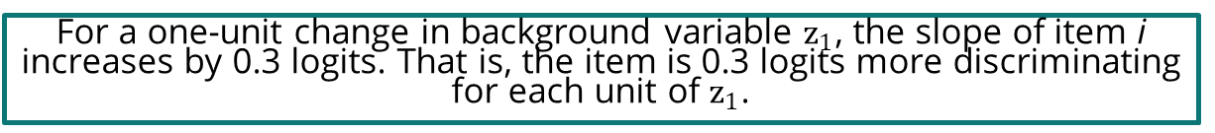


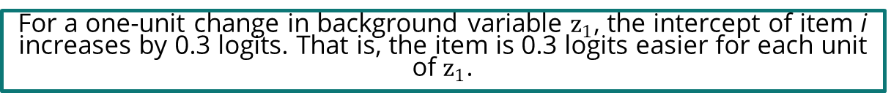
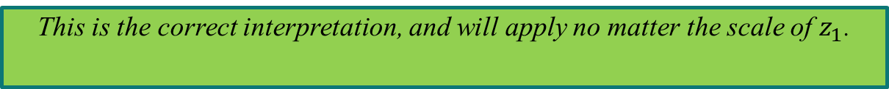
1
Knowledge Check
$logit\left(X_{ij}=1\right)=\left(λ_{j}+0.05z_{1i}−1.0z_{2i}\right)θ_{i}+ν_{j}+0.3z_{1i}−0.2z_{2i}$. In the highlighted term $0.3z_{1i}$, what does the value 0.3 represent?
For members of the focal group, item i is 0.3 logits more difficult than for members of the reference group.
A
This response assumes that the background variable z_1 is a binary grouping variable, but that need not be the case in MNLFA. An increase in the intercept also represents the item becoming easier, not more difficult.
This is the correct interpretation, and will apply no matter the scale of $z_{1}$.
For a one-unit change in background variable $z_{1}$, the intercept of item i increases by 0.3 logits. That is, the item is 0.3 logits easier for each unit of $z_{1}$.
B
For a one-unit change in background variable $z_{1}$, the slope of item i increases by 0.3 logits. That is, the item is 0.3 logits more discriminating for each unit of $z_{1}$.
C
Slope moderation is captured in a different part of the equation: $\left(λ_{j}+0.05z_{1i}−0.1z_{2i}\right)θ_{i}$
Previous Question
Next Question

Slide 3
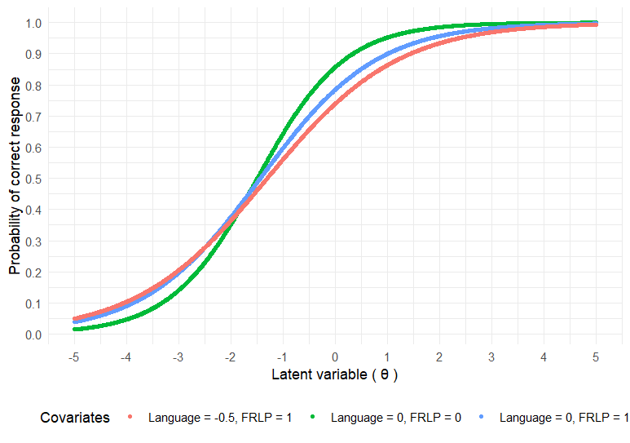
2
Knowledge Check
This plot shows an item with uniform and non-uniform DIF, to use traditional DIF terminology. In MNLFA terms, which of the following are true?
Yes – intercept moderation represents a constant difference in the logit of a correct response for each unit change in the background variable.
A
Intercept moderation is analogous to uniform DIF.
Yes – slope moderation represents a difference in the steepness of the item response function as a function of the background variable, leading the item response function curve / item characteristic curves at different levels of the background variable to cross.
B
Slope moderation is analogous to non-uniform DIF.
Intercept moderation is analogous to non-uniform DIF.
C
This is flipped – intercept moderation corresponds to uniform DIF.
Slope moderation is analogous to uniform DIF.
D
This is flipped – slope moderation corresponds to non-uniform DIF.
Previous Question
Next Question

Slide 4

3
Knowledge Check
Consider the equation from section 3, slide 12: $θ\sim N(0+0.8{lang}_{i}+1.2{FRLP}_{i},σ^{2}∗e^{0.5{lang}_{i}+0∗{FRLP}_{i}})$. Interpret the variance term of the equation.
For each unit increase in lang, the variance of the θ distribution increases by 0.5.
A
This describes a linear relation, but the relation is log-linear.
For each unit increase in lang, the variance of the θ distribution is multiplied by 0.5.
B
This does not accurately describe the term – the relation described here would imply that variance goes down as lang goes up, but the equation represents a relation in which lang is positively and log-linearly associated with θ variance.
For each unit increase in lang, the logarithm of the variance of the θ distribution increases by 0.5.
C
This is correct – a one-unit increase in lang add 0.5 to the exponent in the term capturing the variance of θ. Because this number is positive, that means that variance increases with lang, but the relation is log-linear, not linear, to prevent negative variances.
Previous Question
Next Question

Slide 5
4
Knowledge Check
Which of the following statements about MNLFA estimation is true?
LASSO regularized estimation procedures can produce impact estimates while capturing DIF on all items.
A
This is not true – for the model to be identified, at least one item must be DIF-free for each background variable (assuming impact is estimated). Frequentist regularization does, however, “pseudo-identify” the model, meaning that estimation can begin without specifying the anchor item ahead of time.
Maximum likelihood estimation (non-regularized/traditional) does require at least one a priori anchor item to be specified for each background variable.
B
Maximum likelihood estimation does not require a prior anchor items.
This is true if using a regularizing prior (e.g., spike-and-slab), but false if uninformative priors are used (see, e.g., Enders et al., 2024).
C
Bayesian estimation via Markov Chain Monte Carlo does not require a prior anchor items.
Regularized estimation procedures do not require specifying anchor items a priori.
D
This is correct. The specifics differ by regularization approach, but neither frequentist (e.g., LASSO) nor Bayesian (e.g., spike-and-slab) priors require a prior anchor items. See Belzak and Bauer (2020) and Chen et al. (2022).
Previous Question
Next Question

Slide 6
You have reached the end of this learning check
Please click anywhere to exit!
Previous Question

